Slide 1


Indian Premier League (IPL) Win/Loss Prediction using Machine Learning
Bachelor of Technology in Computer Science and Engineering
Presented by :
Suchanda Banerjee
Promit Dey
Sanket Bakshi
Upasak Sharma Choudhury
GROUP 14
University Roll No.
10800120085
10800120097
10800120084
10800120123
Under the Guidance of
Dr. Debasis Chakraborty
(Professor)
Asansol Engineering College
AFFILIATED TO
MAULANA ABUL KALAM AZAD UNIVERSITY OF TECHNOLOGY

Slide 2
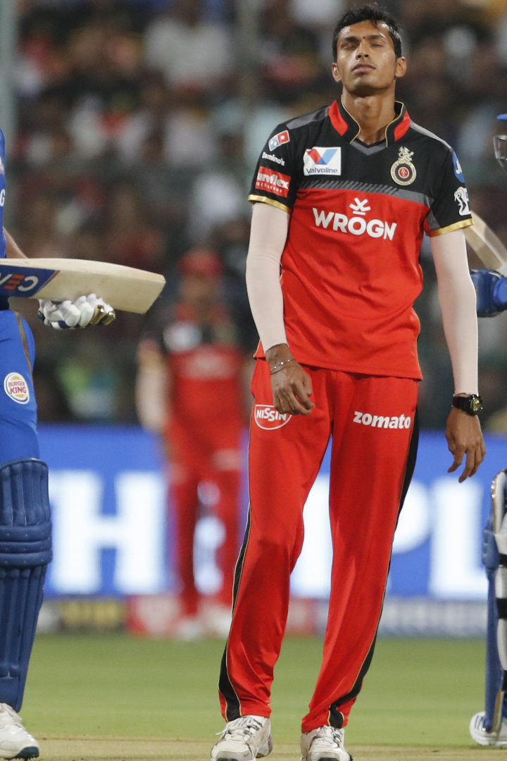
IPL Win/Loss Prediction using Machine Learning
Cricket is not just a game, it's a religion. In India, and around the world, people love to watch the Indian Premier League (IPL). IPL is a professional Twenty20 cricket league famous for its thrilling matches and nail-biting finishes. The importance of win/loss prediction in IPL has been growing over the years, and machine learning can help predict these outcomes with incredible accuracy.

Slide 3
Introduction
This project focuses on using machine learning, specifically Logistic Regression, to predict the outcomes of IPL cricket matches. The goal is to enhance predictions of team scores and game results by analyzing historical data and various influencing factors like team performance, team statistics, runs left, wicket fallen, etc. The machine learning models, organized into a taxonomy including supervised learning and Logistic Regression, are trained on a dataset comprising team names, match venue, target, and match winner. The Logistic Regression algorithm, suitable for binary classification tasks, is employed to predict whether a team will win or lose a match. The process involves collecting historical IPL data, splitting it into training and test sets, training the model on the former, and evaluating its performance on the latter. Once trained, the Logistic Regression model can be used to predict match outcomes for future IPL matches by inputting relevant data and obtaining the probability of each team winning.

Slide 4
Importance of Win/Loss Prediction in IPL
Team Performance Analysis
Better Decision Making
IPL win/loss prediction can help fans, coaches, and team owners in critically analyzing the team’s performance on various parameters.
Prediction of win/loss outcomes increases the chances of making informed betting decisions or for team owners to strategize the team better.
Increased Fan Engagement
Media and Broadcasting
A win/loss prediction algorithm enhances the viewing experience for the viewers. It would help broadcast media in generating more revenues through advertisement since accurate and responsible predictions can help to increase the viewership of the matches.
Through proper prediction, fans can predict the match outcomes better and engage in their favorite sport better.

Slide 5
Data Collection and Preprocessing
1
Sources of data
Data is often collected from multiple sources such as Websites, Cricket news, social media, and other online APIs.
Cleaning and feature selection
2
This step helps in removing duplicate or inappropriate data and helps extract relevant features that will assist in predicting the IPL win/loss outcomes.
3
Feature Engineering
Feature Engineering is essential for proper machine learning functioning before we use the selected features for prediction.
Splitting the data
4
The data is split into training and test sets. Most commonly, 70% of the data is used for training, while the rest is kept for testing the model.

Slide 6
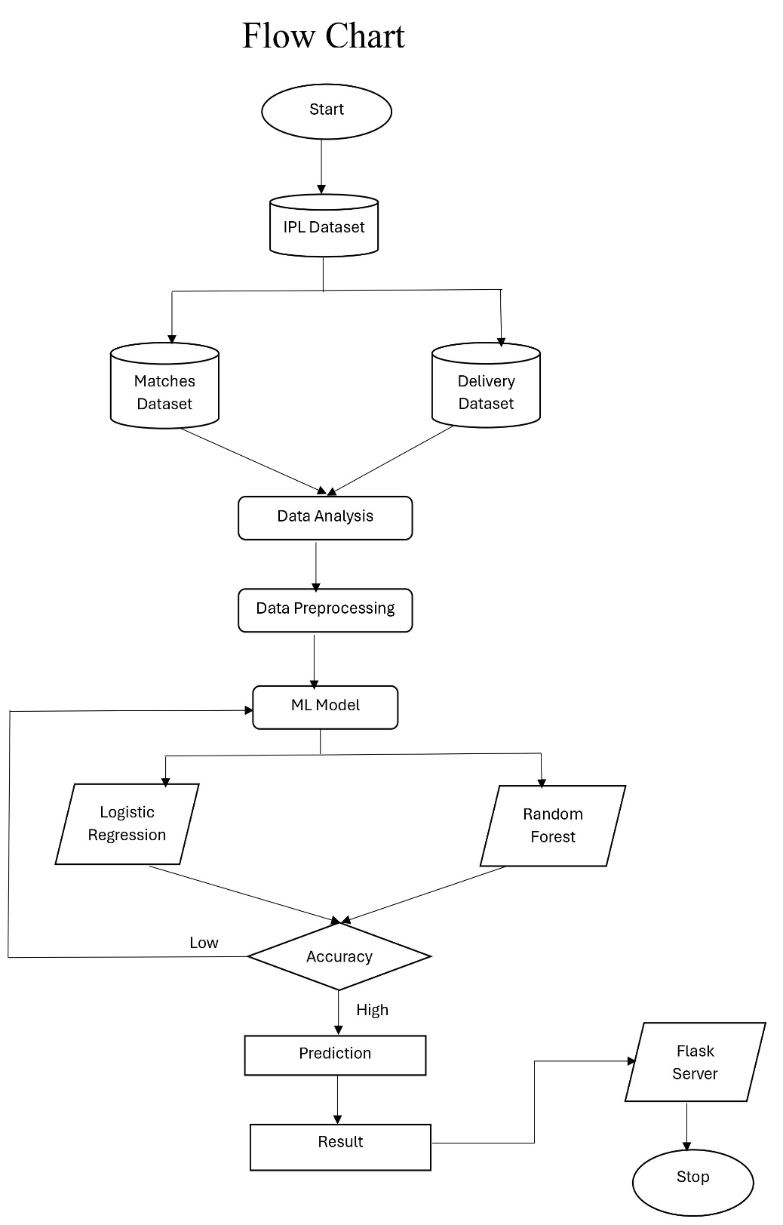
Flow Chart
Flow diagram illustrating the sequential application of data preprocessing, feature engineering, and machine learning algorithms for IPL win/loss prediction, providing a systematic overview of the predictive modeling process.

Slide 7
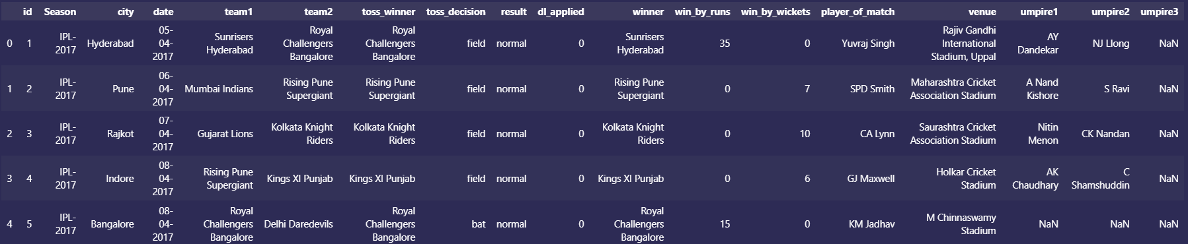
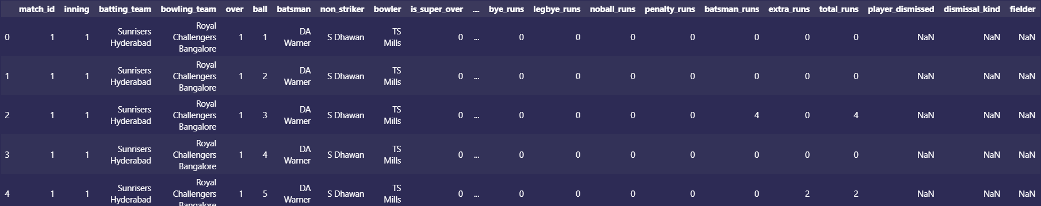
Collecting Data
“Matches.csv” dataset
“Deliveries.csv” dataset

Slide 8
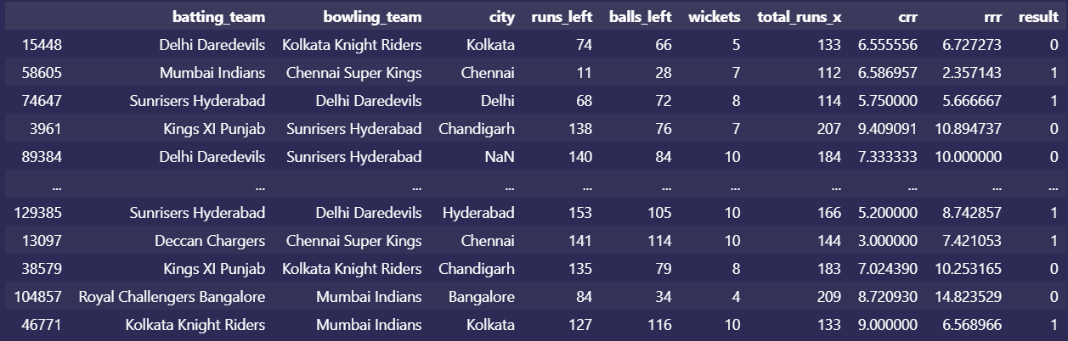
Processing Data
This table depicts the CRR and RRR, by which we can predict the teams that can win/lose

Slide 9
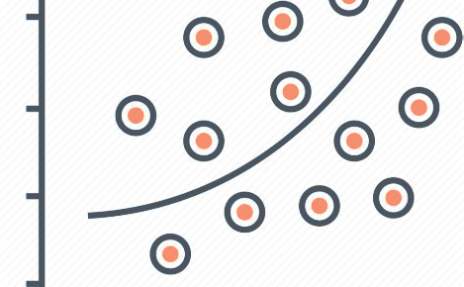
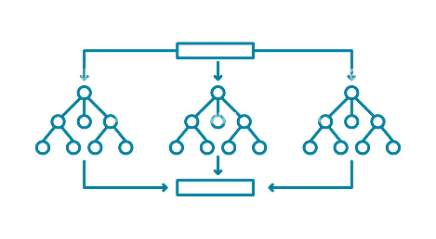
Machine Learning Algorithms for Prediction
Logistic Regression
Random Forest
Simple and powerful classification model that uses a linear function to determine the relation between input data and target variable.
Ensemble algorithm known for its robustness, handles missing data, don't overfit, and hence should be part of the model evaluation phase.

Slide 10
Model Training and Evaluation
Split Data
Model Evaluation
Performance Insights
Training, Testing, and Validation sets are splitting data. Logistic Regression algorithm is trained and validated by the training set and performance is assessed by the testing set.
Evaluation of the model is based on the accuracy of prediction with cross validating to make the model generalize better.
In-depth analysis of the prediction performance provides insights into what team should change regarding the game strategy.

Slide 11

IPL Win/Loss Prediction Application
1
Use Cases
The application could help bookmakers, Fantasy game applications, news channels to make their own predictions and in forecasting game analysis, improve user-engagement, and increase the chances of viewership.
2
Advantages
The predictions can help to identify the probability of occurrence of events that influence the match's win/loss outcomes to the highest possible level. This chance might help to turn the odds around and contribute to sports enthusiasts' financial gains through correct sports betting decisions.
3
Limitations
One of the biggest limitations of using machine learning-based IPL win/loss prediction is the lack of interpretability of the model. It means that it might get difficult to assess whether the predictions generated are biased and fair.

Slide 12

Conclusion
Machine learning has proved to be an efficient method to predict IPL win/loss outcomes with high accuracy. The popularity of IPL is increasing each year, and this data analysis technique will make it easier to predict the winning teams. In the future, advancements in machine learning and data analytics will make IPL predictions even more precise and interesting.

Slide 13
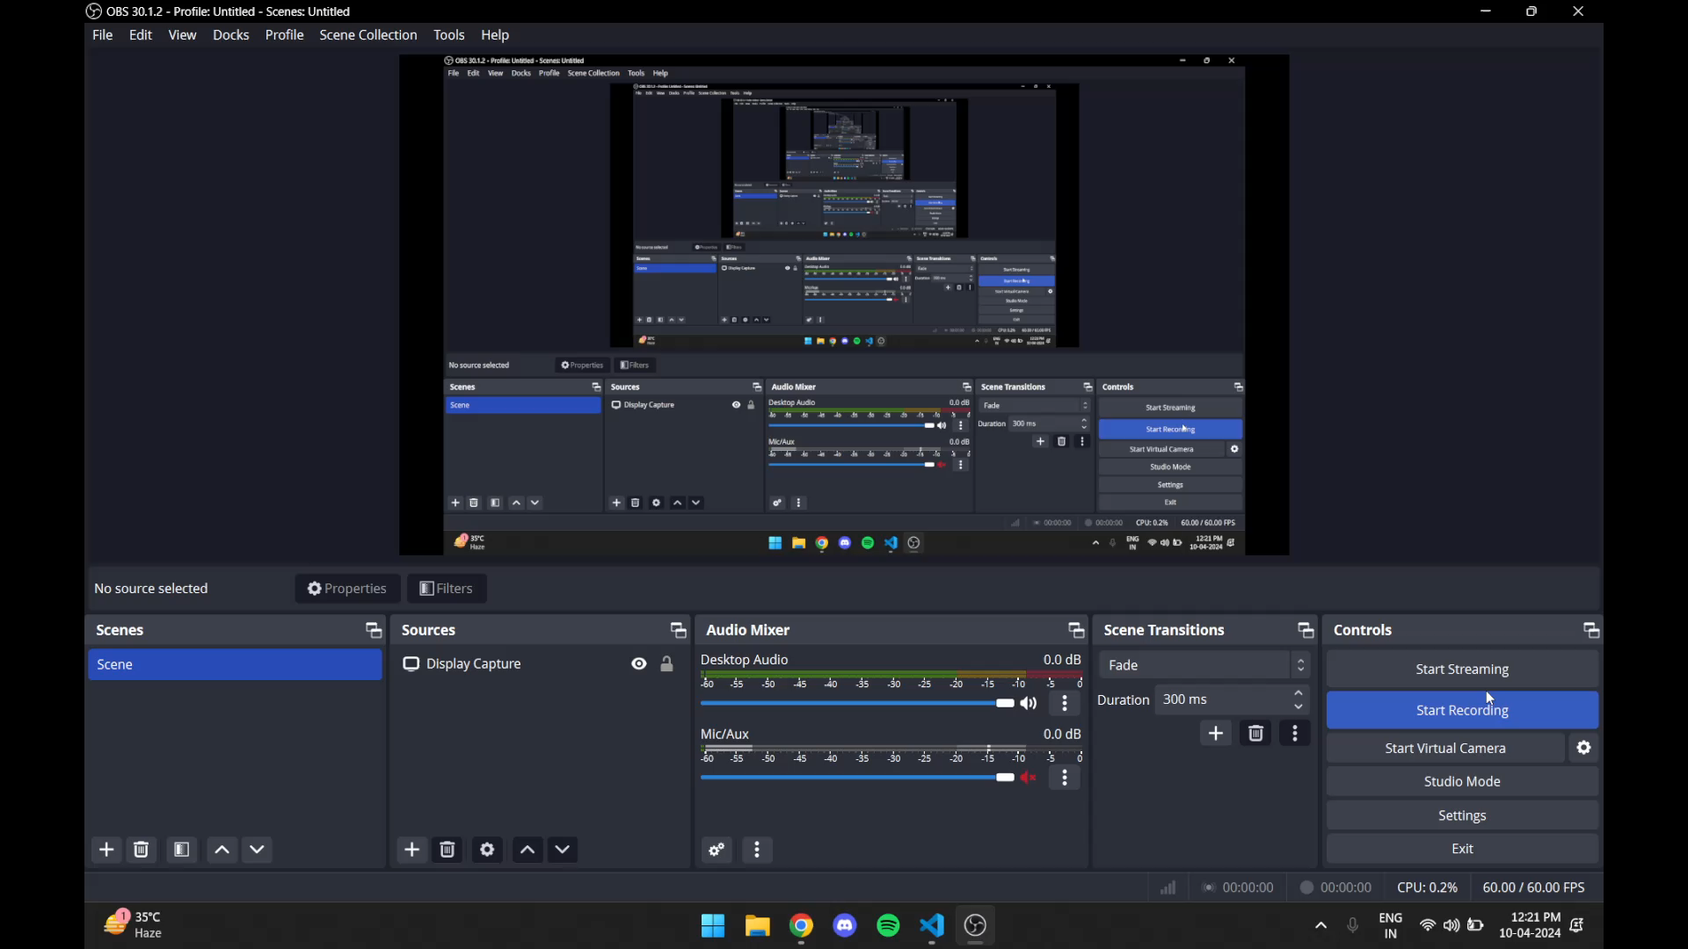

Slide 14


